Slide 1

An undertaking of Bhaktapur Municipality KHWOPA ENGINEERING COLLEGE (Affiliated to Purbanchal University) Libali - 8, Bhaktapur
A PRESENTATION ON ON-THE JOB TRAINING
Presented by:
Birendra Kumar Gupta
Rabindra Khatri
Sumitra Bharati

Slide 2
INTRODUCTION
Short period of time at a workplace
Simple training that students receives
To make students skillful in actual workplace

Slide 3
WORK DESCRIPTION
Hardware Portion:
Solving problems in hardware (RAM problem, hard disk failure, etc.)
Software Portion:
Installing software's in computer labs
Basic Programming (PHP, Python, C-Programming)
Website designing (HTML, CSS, Bootstrap)
Network Portion:
Clamping Ethernet cables
Setup cn-pilot and manageable switch
Cisco coding
Miscellaneous:
Scanning old question papers
MIS work
Create Teams in MS-Teams

Slide 4
OBJECTIVE
To develop the skills and knowledge
To tackle different situations that may arise in the organization
To gain experience

Slide 5
SKILL DEVELOPED
Report Writing (Word)
Data Entry (Excel)
Presentation (PowerPoint)
Networking (Cisco)
Coding (PHP, HTML, CSS, Cisco, Python)
Repair and Troubleshooting

Slide 6
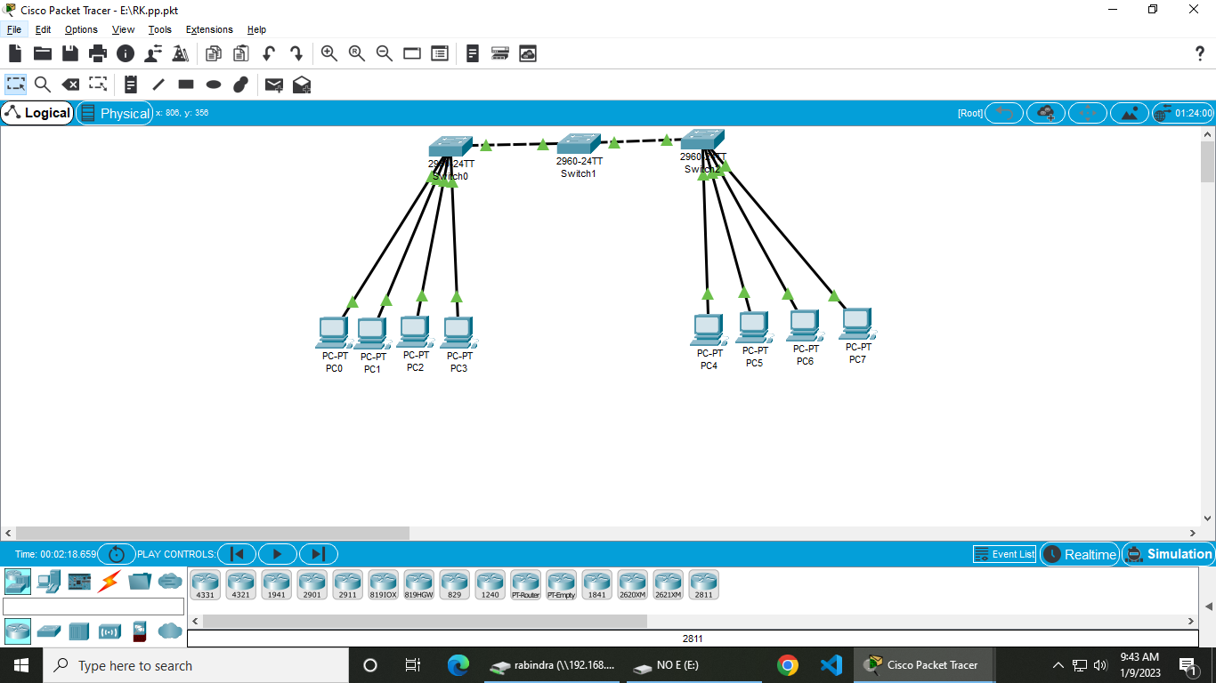
CREATING VLAN
virtual extension of LAN
to improve performance
to tighten security

Slide 7
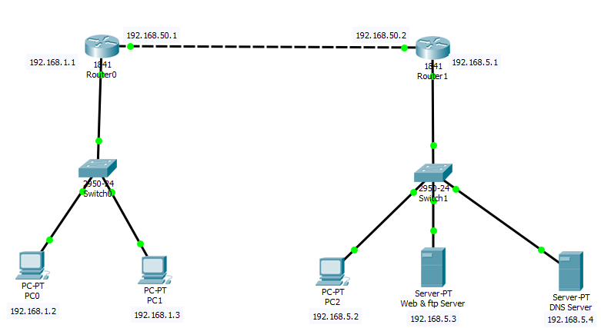
CREATING DNS SERVER
book of the World Wide Web
translate domain name to numeric IP address

Slide 8
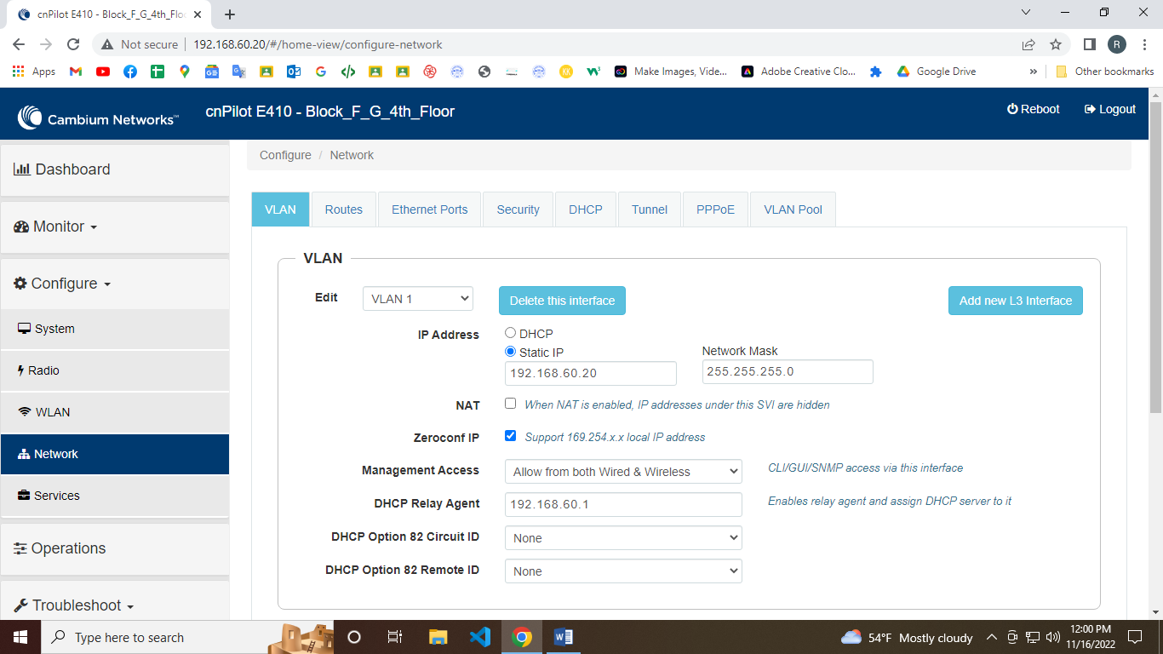

SETUP AND CONFIGURATION OF CN-PILOT
Wi-Fi solution supported by Cambium Networks fixed wireless broadband solutions

Slide 9
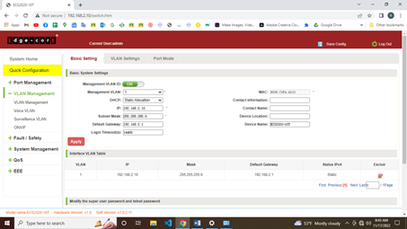

SETUP AND CONFIGURATION OF MANAGEABLE SWITCH
Configuring IP address
Let user to adjust each port on switch

Slide 10
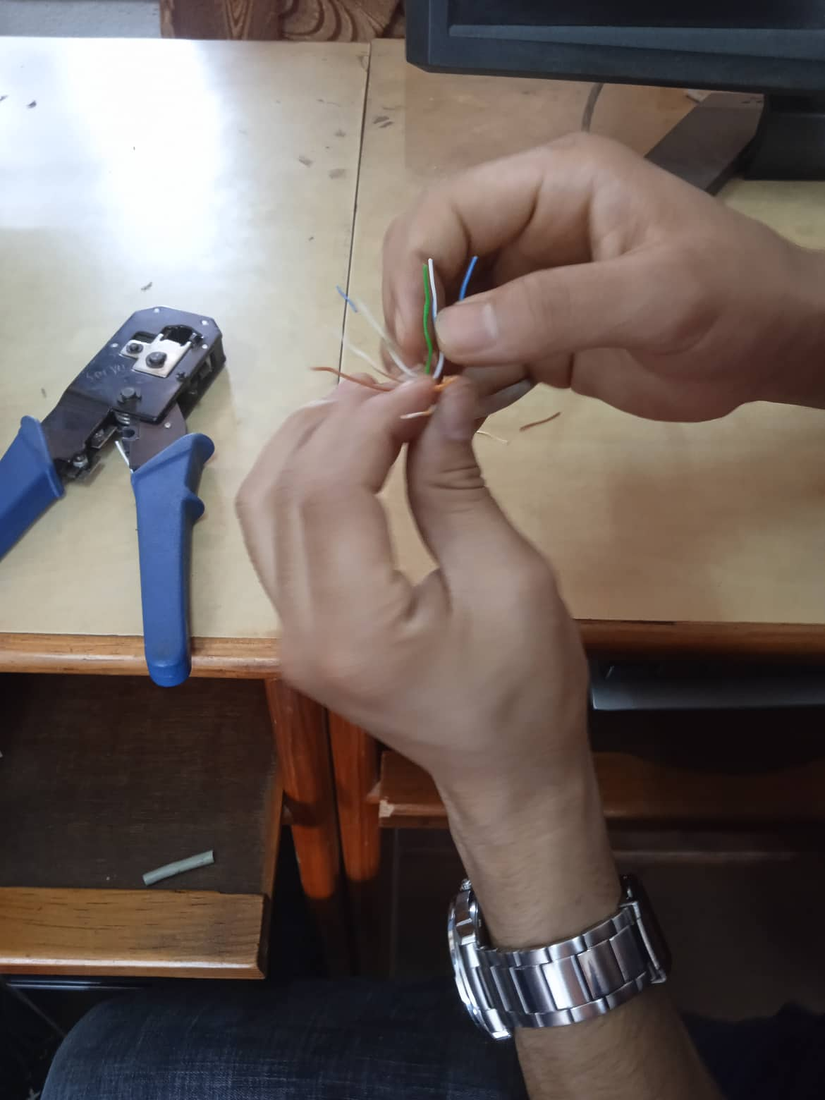
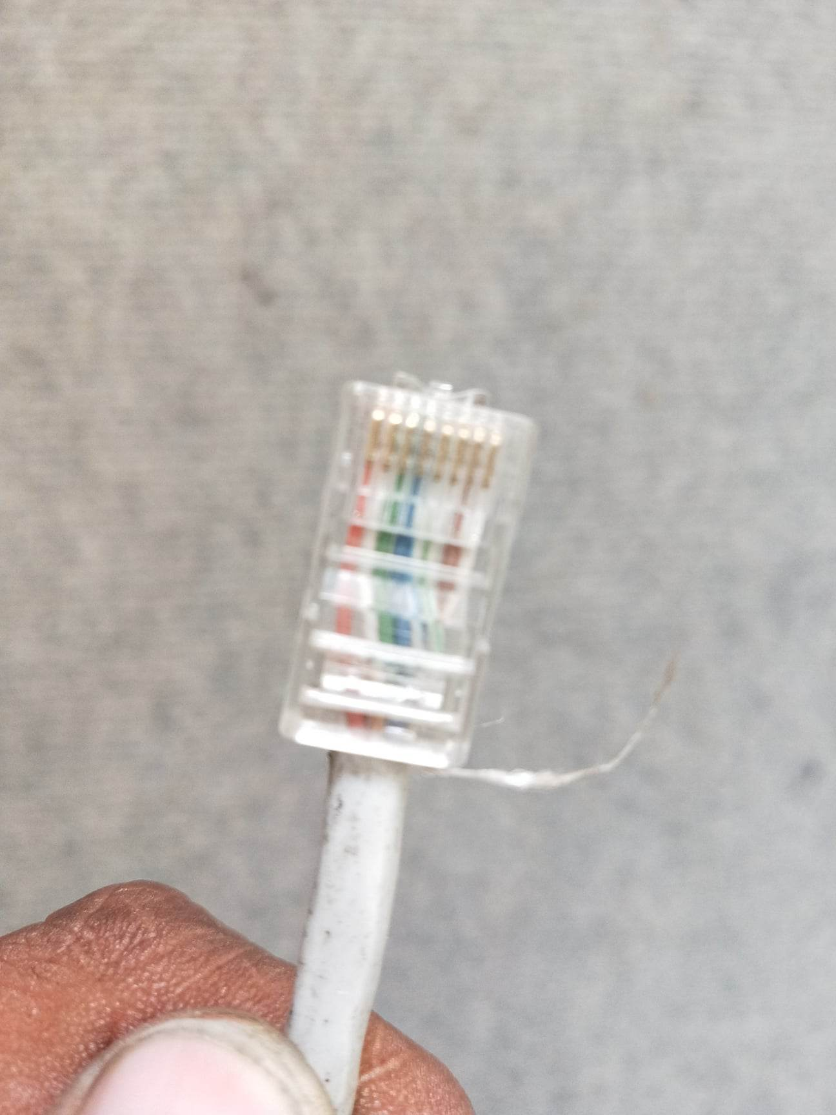
CLAMPING ETHERNET CABLE
Standard method
RJ45

Slide 11
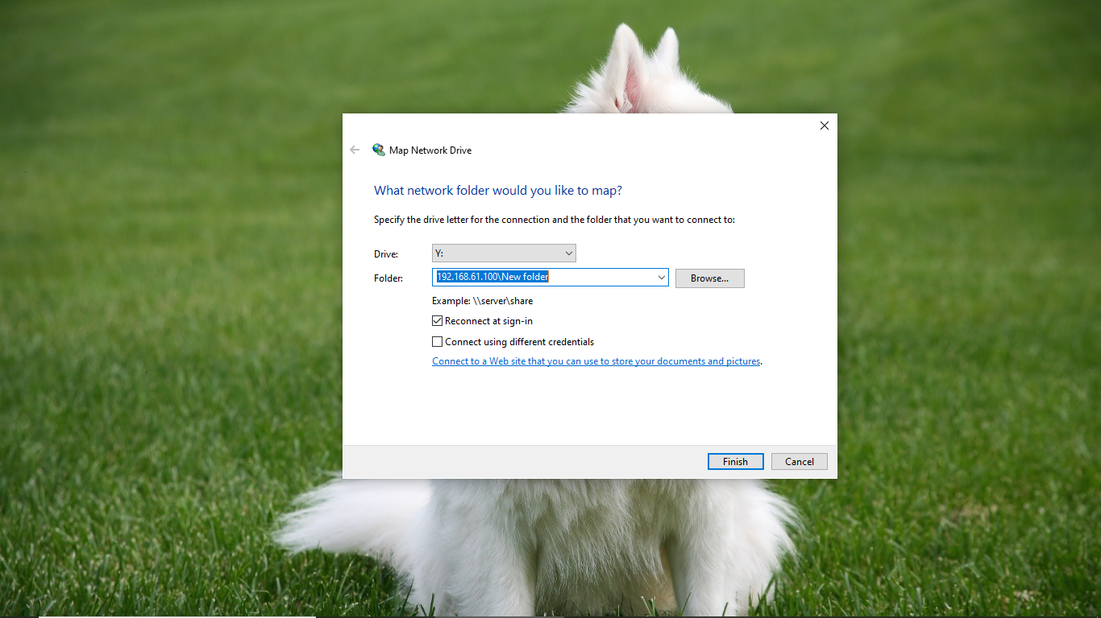
CREATING NETWORK DRIVE
Easy to share data and files

Slide 12


WEBSITE
Editing template using (HTML, CSS, PHP, JavaScript)

Slide 13
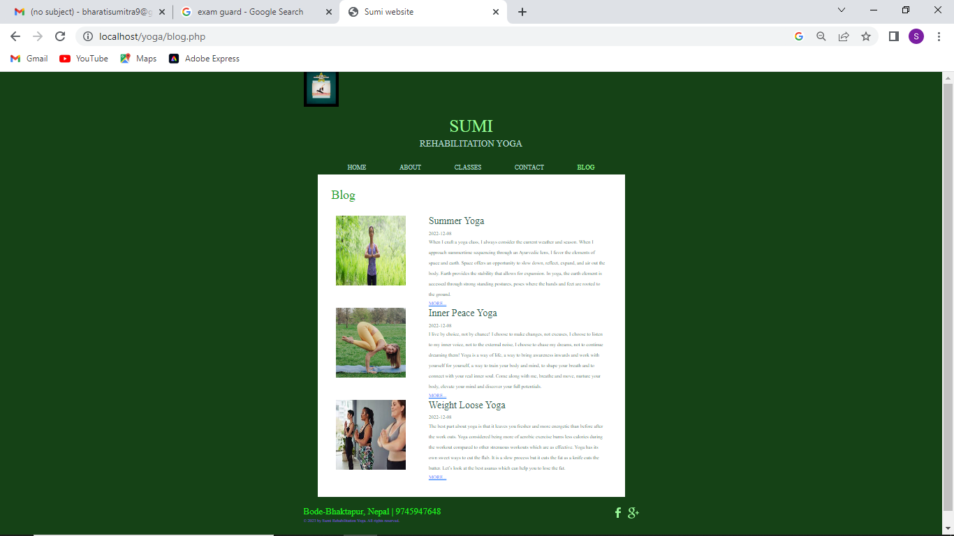
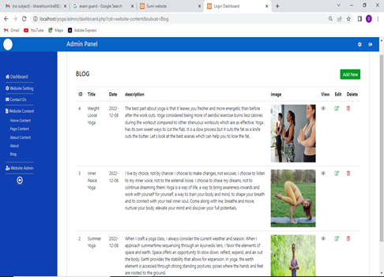
ADMIN PANEL OF WEBSITE
Blog content
About
Contact
About content
Page content

Slide 14
MICROSOFT WORD
Preparation of Report i.e., monthly reports
Preparation of mark sheet using mail merge

Slide 15
MICROSOFT POWERPOINT
Basics of PowerPoint
Making Presentation

Slide 16
MICROSOFT EXCELS
Data entry
Mail merge
Using functions
= sum(value1, value2)
= A1/B1
=Average(number1,number2)

Slide 17
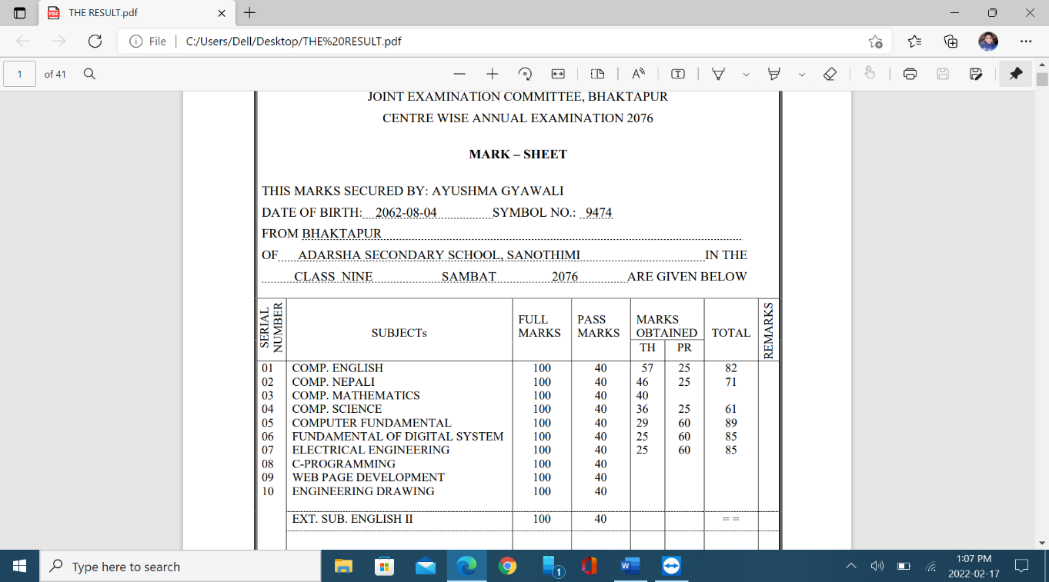
RESULT PREPARATION USING MAIL MERGE
Used existing template for mail merge

Slide 18
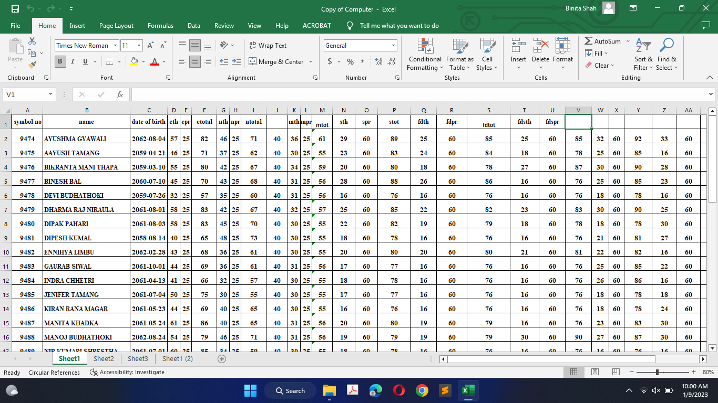
DATA ENTRY OF RESULT

Slide 19
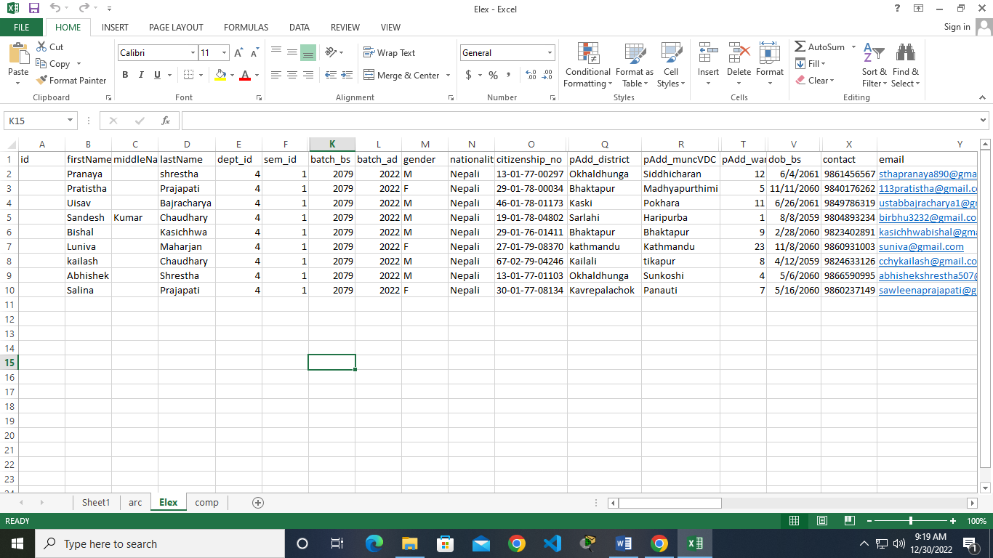
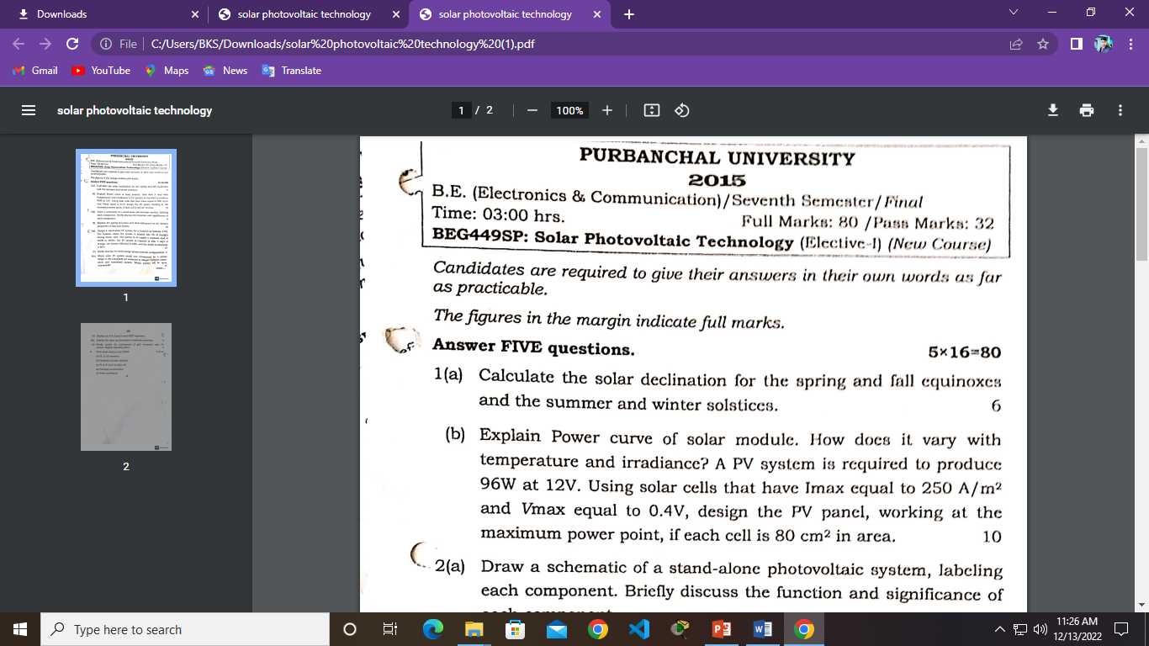
MIS WORK
Data entry of new admitted student
Scanning old question paper of exam
Data entry of scholarship

Slide 20
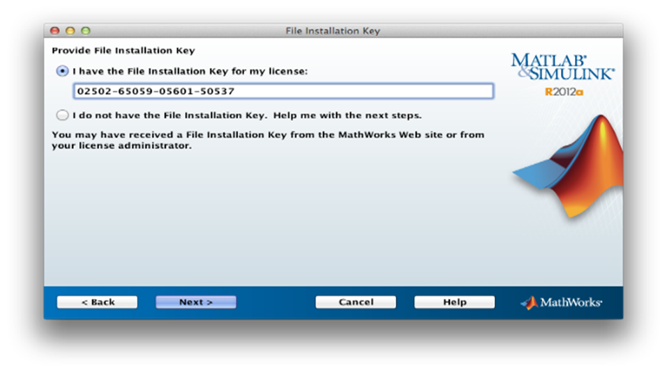
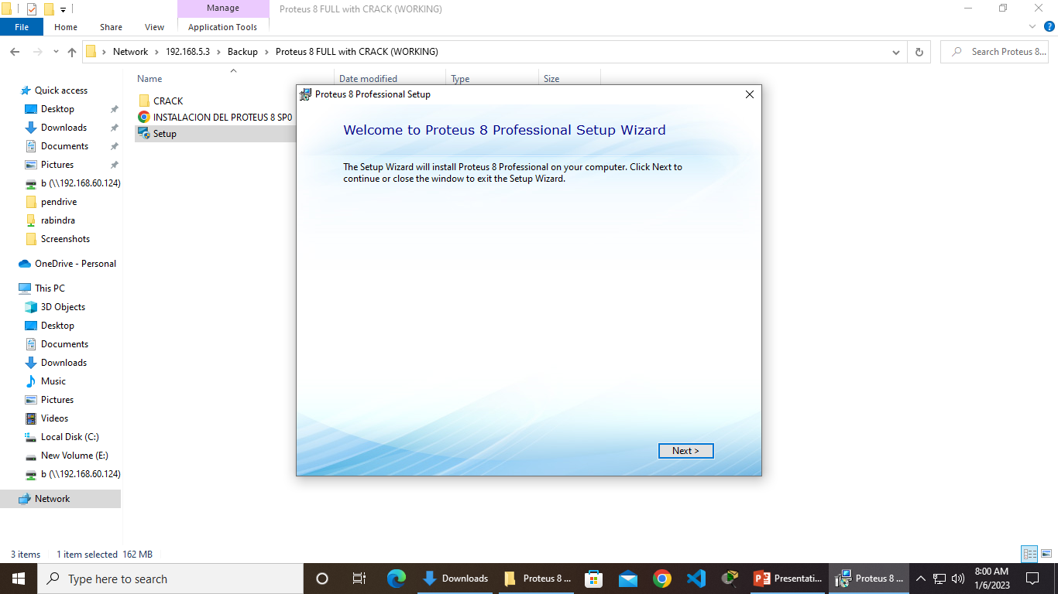
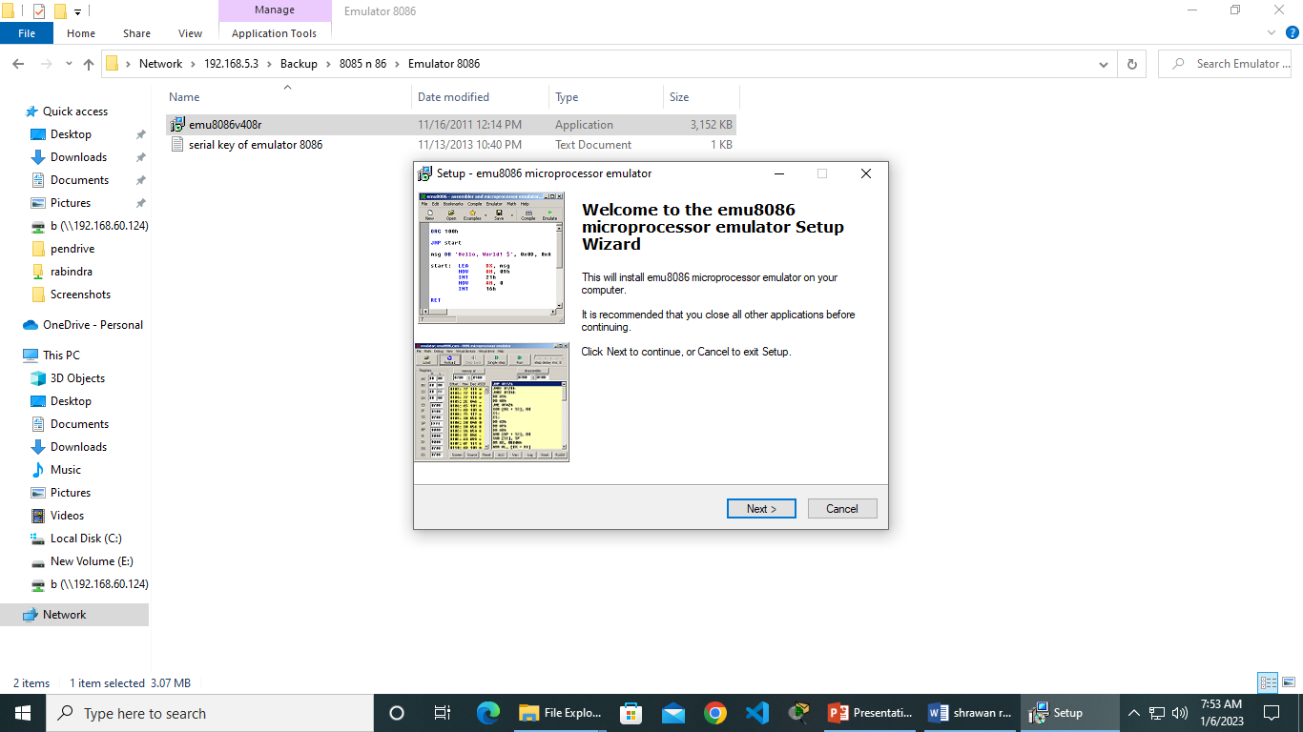
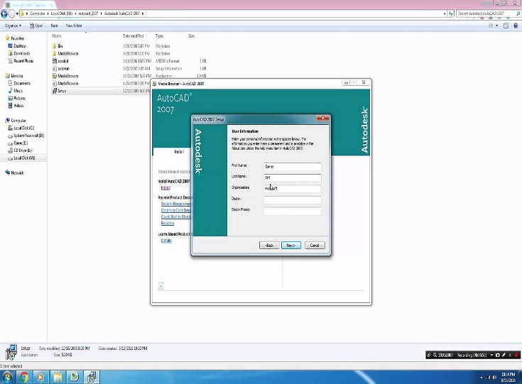
SOFTWARES INSTALLED IN LABS
Software like Fonts, office 13, adobe reader, win rar, TC7- win 7TC, 8085, 8086, AutoCAD 2007, Proteus, Mat lab 2013, ArcGIS, kail.

Slide 21
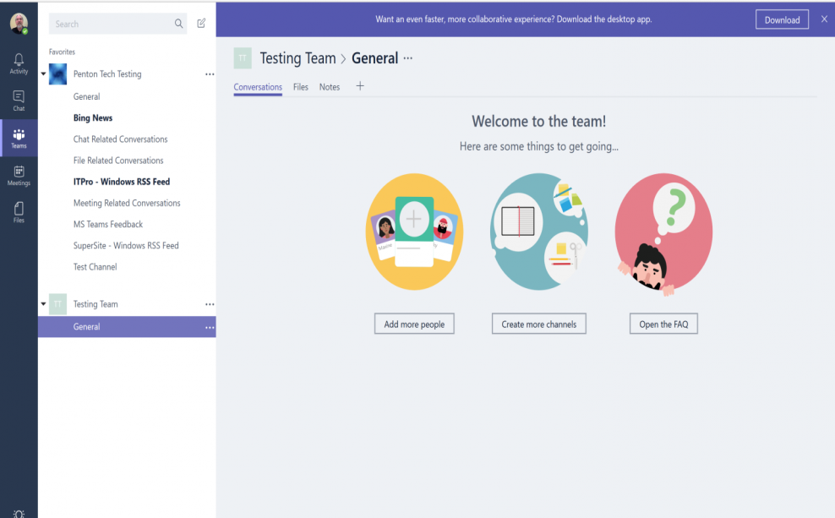
CREATING TEAMS ON MS TEAMS

Slide 22
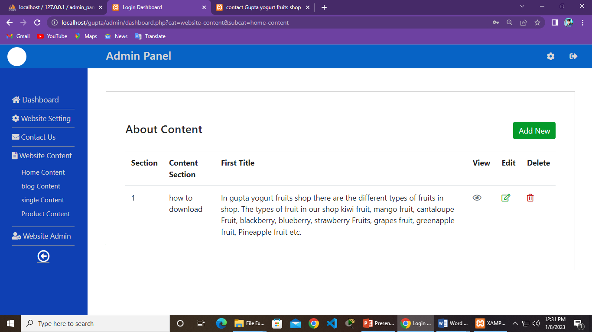
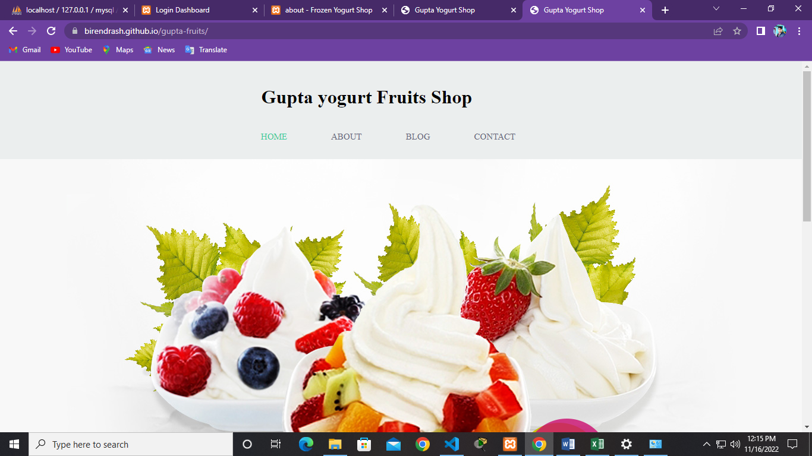
WEBSITE
Editing website insert , update ,delete from admin panel

Slide 23
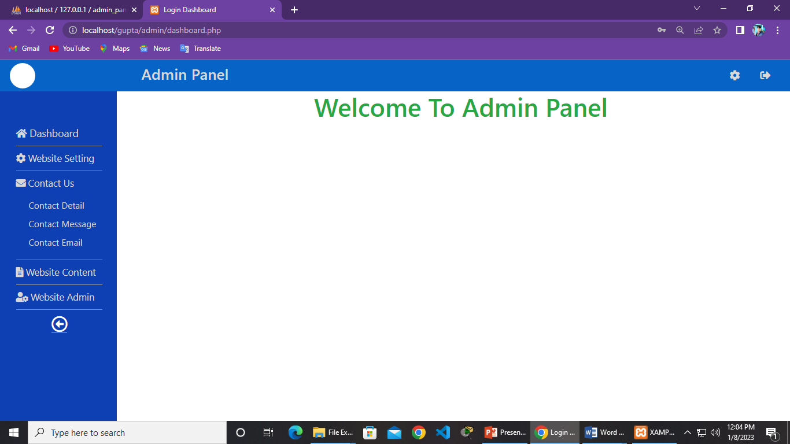
ADMIN PANEL OF WEBSITE
Admin panel dashboard for editing the website easy

Slide 24


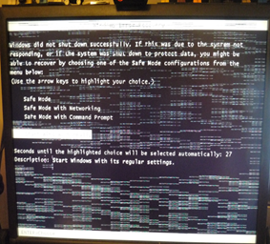
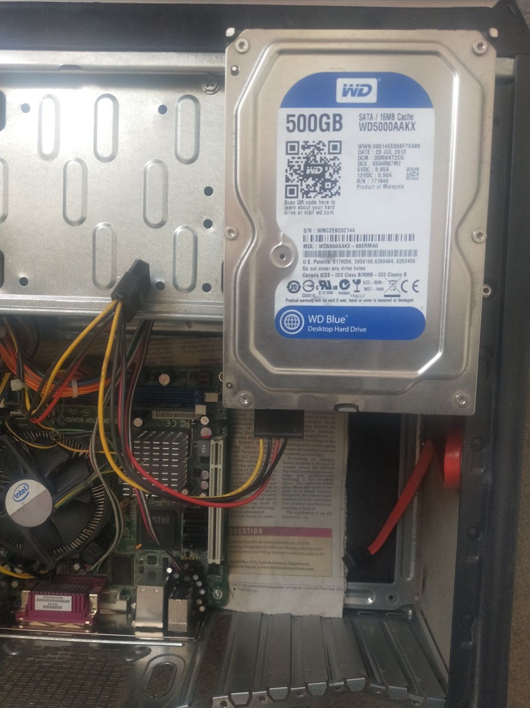
HARDWARE FAILURE FACED IN LABS
Power cable failure problem
SMPS failure Problem
Hard disk failure
Ram failure problem

Slide 25
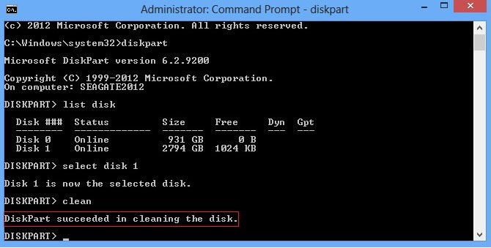


SOFTWARE PROBLEMS
Hard disk 0 error problem
Blue screen problems
Windows crash

Slide 26
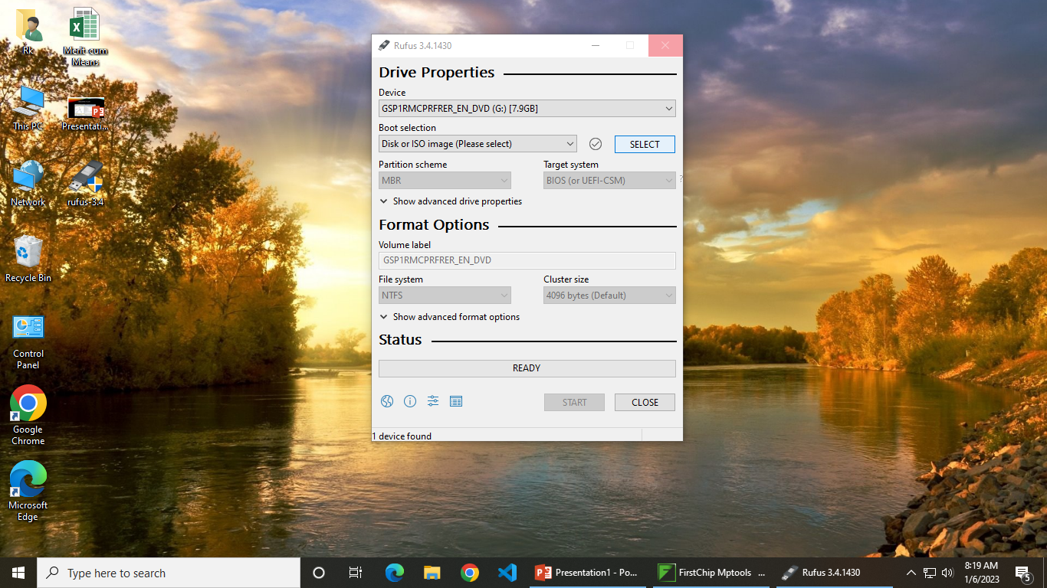
Making Bootable pen drive
Computer
Rufus
Windows ISO file
Pen drive

Slide 27
PHP PROGRAMMING LANGUAGE
Server side scripting language
open-source and free
used to manage dynamic content, databases, building websites

Slide 28
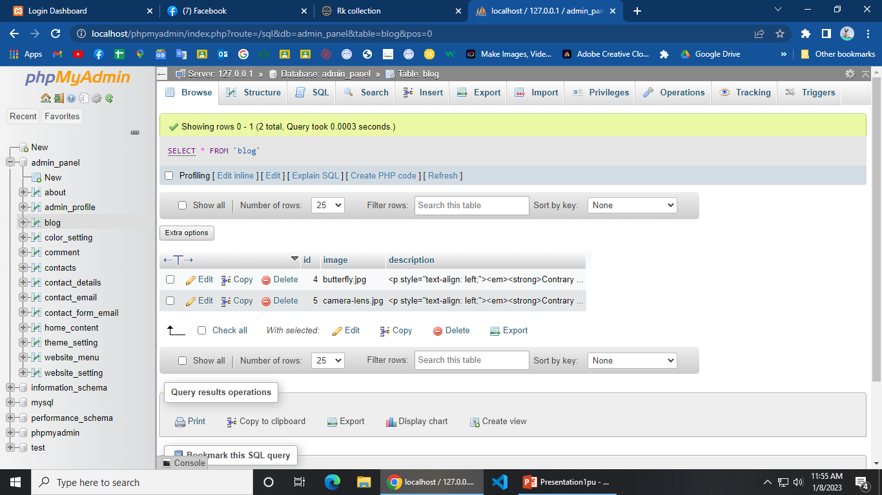
DATABASE
CRUD Operation (CRUD stands for Create, Read, Update, and Delete) in program
SQL Query (SELECT, INSERT, DELETE, UPDATE) for fetching/inserting/delete/update data in program

Slide 29
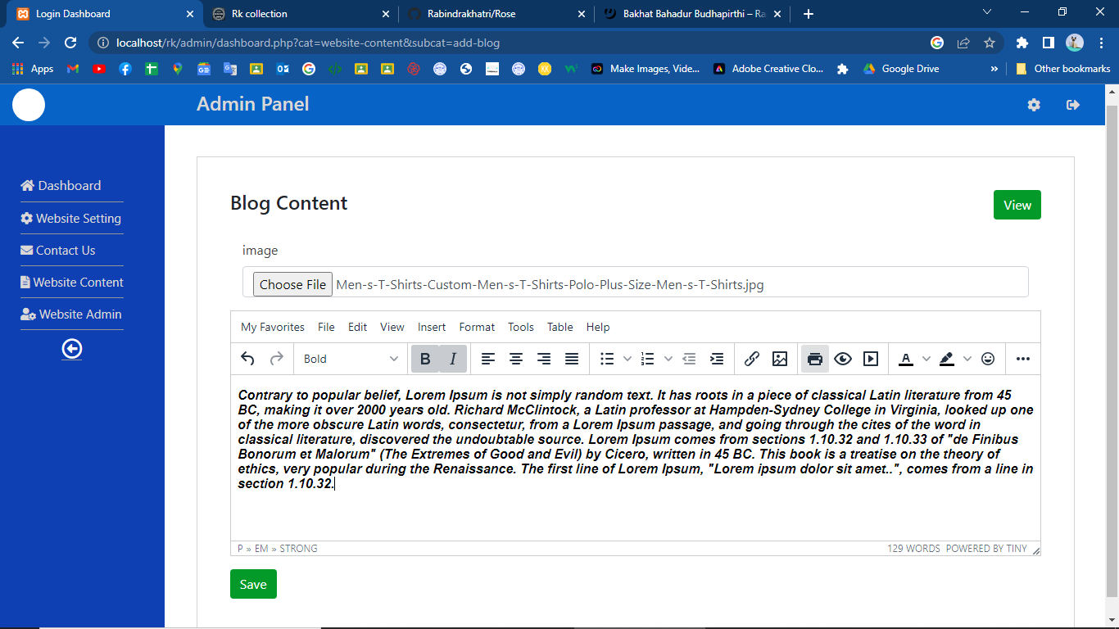
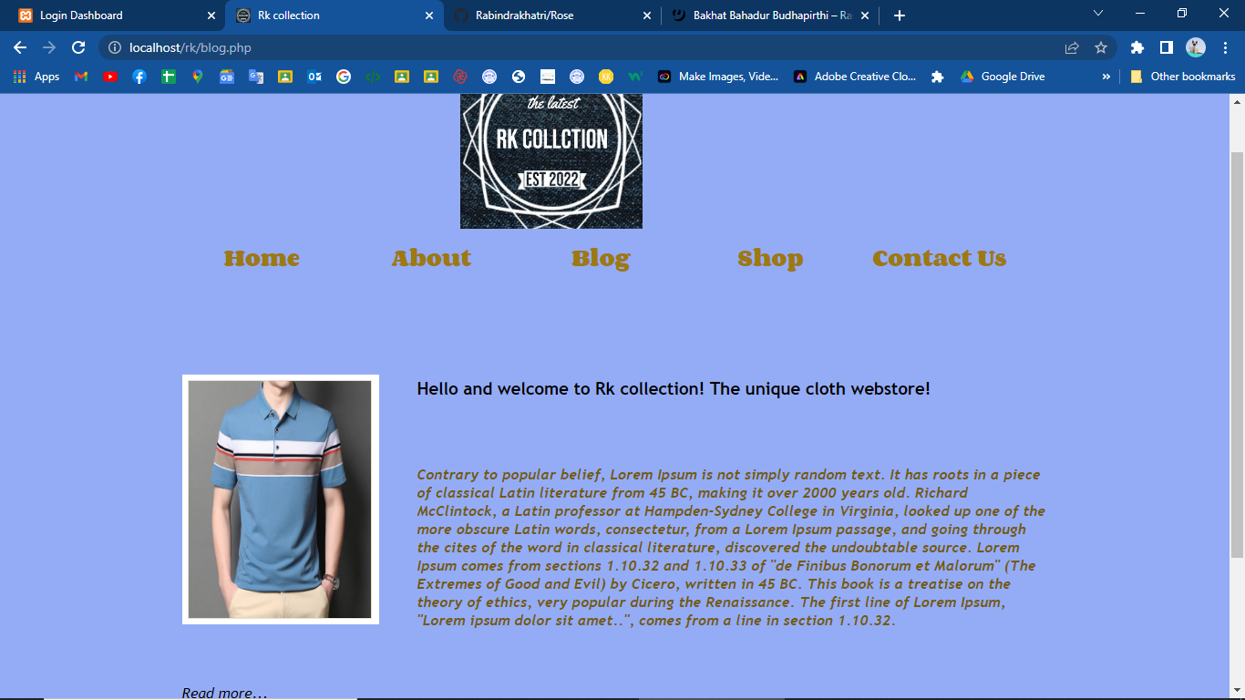
WEBSITE
Inserting blog content

Slide 30
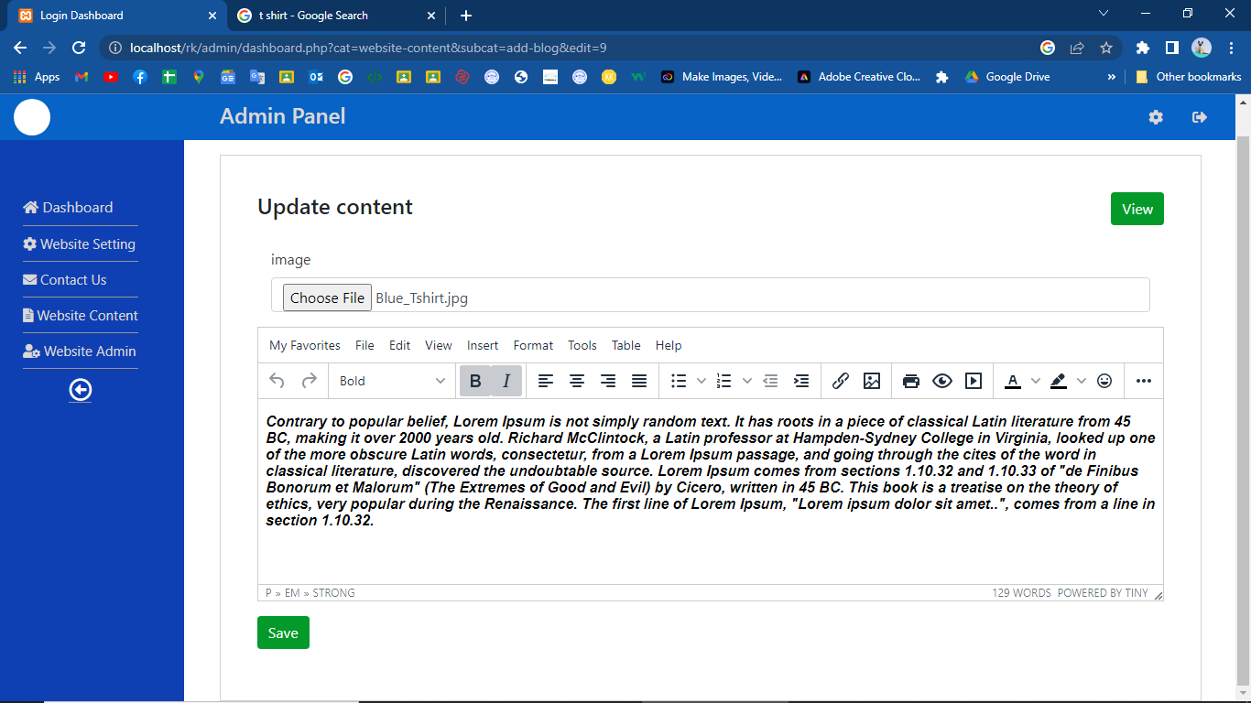
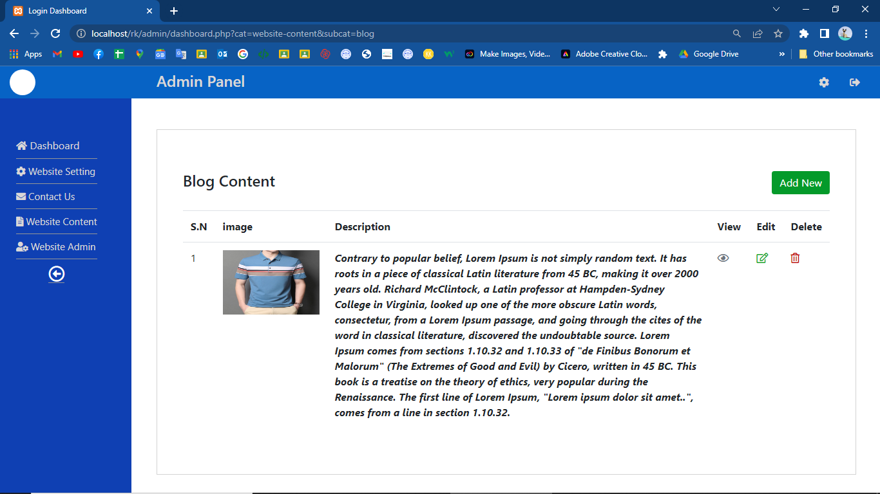
WEBSITE CONTINUE…
Updating blog content

Slide 31
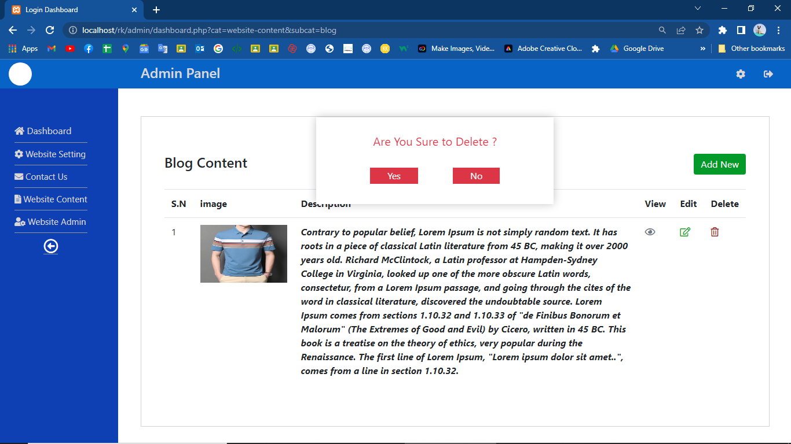
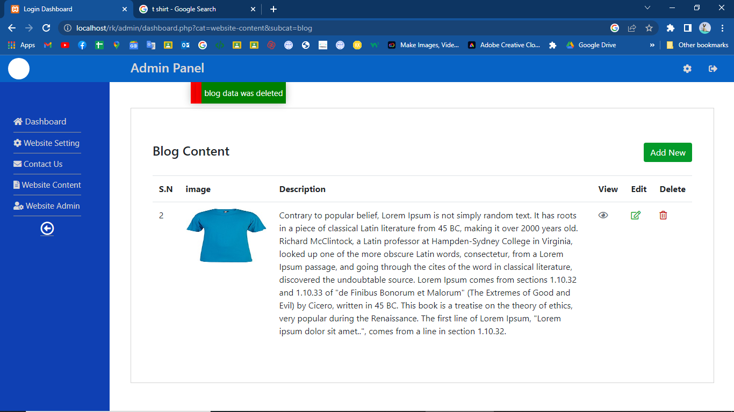
WEBSITE CONTINUE…
Delete blog content

Slide 32
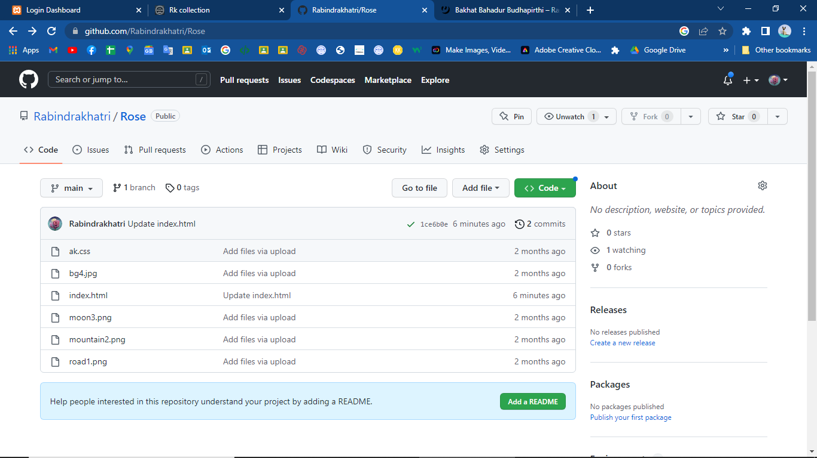
GITHUB REPOSITORY
contains all of the project files
was used to publish static website

Slide 33
THANK YOU !!!

